Slide 1
Fully Interactive Portfolio website
CAPSTONE PROJECT
Presented By:
1. Name - Kashifa Shah
2. College Name- Medicaps University
3. Department - Engineering btech -cse

Slide 2
OUTLINE
Problem Statement (Should not include solution)
System Development Approach (Technology Used)
Algorithm & Deployment (Step by Step Procedure)
Result
Conclusion
Future Scope(Optional)
References

Slide 3
PROBLEM STATEMENT
Many developers struggle to present their skills and projects in an engaging way. A traditional resume lacks interactivity and visual appeal. This project solves that by creating a dynamic, personalized portfolio website. It will include sections like About Me, Skills, Projects, and Contact with smooth navigation and animations.

Slide 4
SYSTEM APPROACH
Frontend Technologies:
HTML5 – Structure of the webpage
CSS3 – Styling and responsive layouts
JavaScript – Dynamic interactivity (cart, filtering, total calculation)
-React js - for component making and making pages more interactive
Design Approach:
Clean and user-friendly interface
Mobile-responsive design
Modular separation of HTML, CSS, and JS files

Slide 5
ALGORITHM & DEPLOYMENT
Product Catalog Creation
Designed and implemented a dynamic product catalog system with support for:
Product categories
Detailed item attributes (image, price, and description)
Frontend Design : Built a responsive and visually appealing interface using:
HTML and CSS (Grid & Card-based layout)
Interactive Features : Enhanced user experience through interactive JavaScript functionalities:
Add-to-Cart and Remove-from-Cart actions
Real-time cart total calculation
Category-based product filtering
Modal popups for detailed product views
Testing & Compatibility : Ensured optimal performance across devices and browsers:
Cross-browser compatibility checks
Mobile responsiveness testing
Deployment : Deployed the project for public access using:
GitHub Pages
Netlify (for streamlined and free hosting)

Slide 6
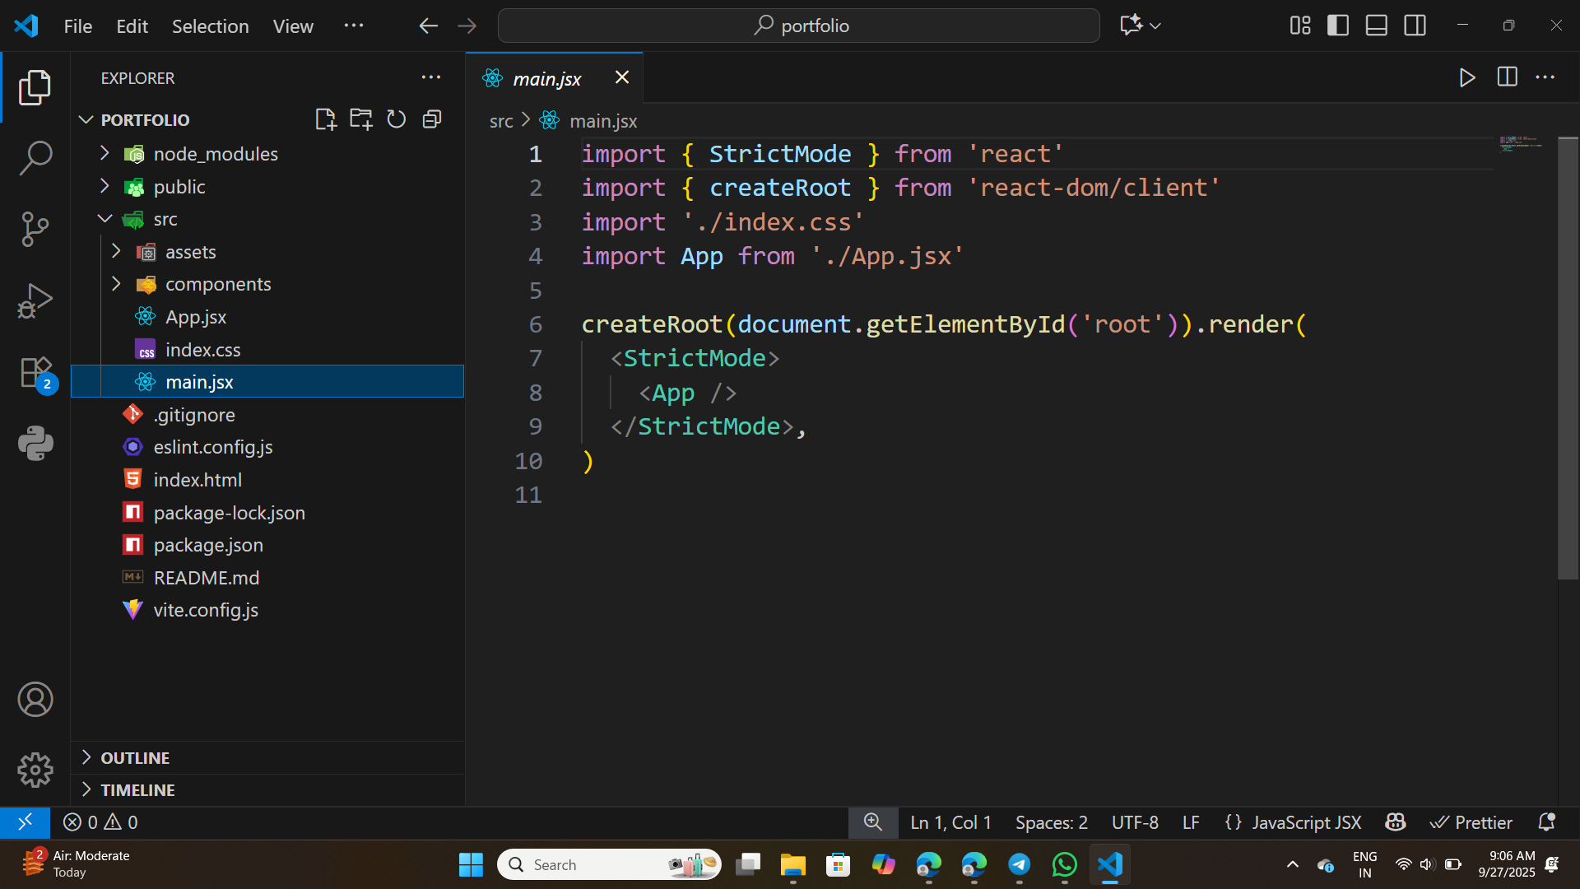
RESULT

Slide 7
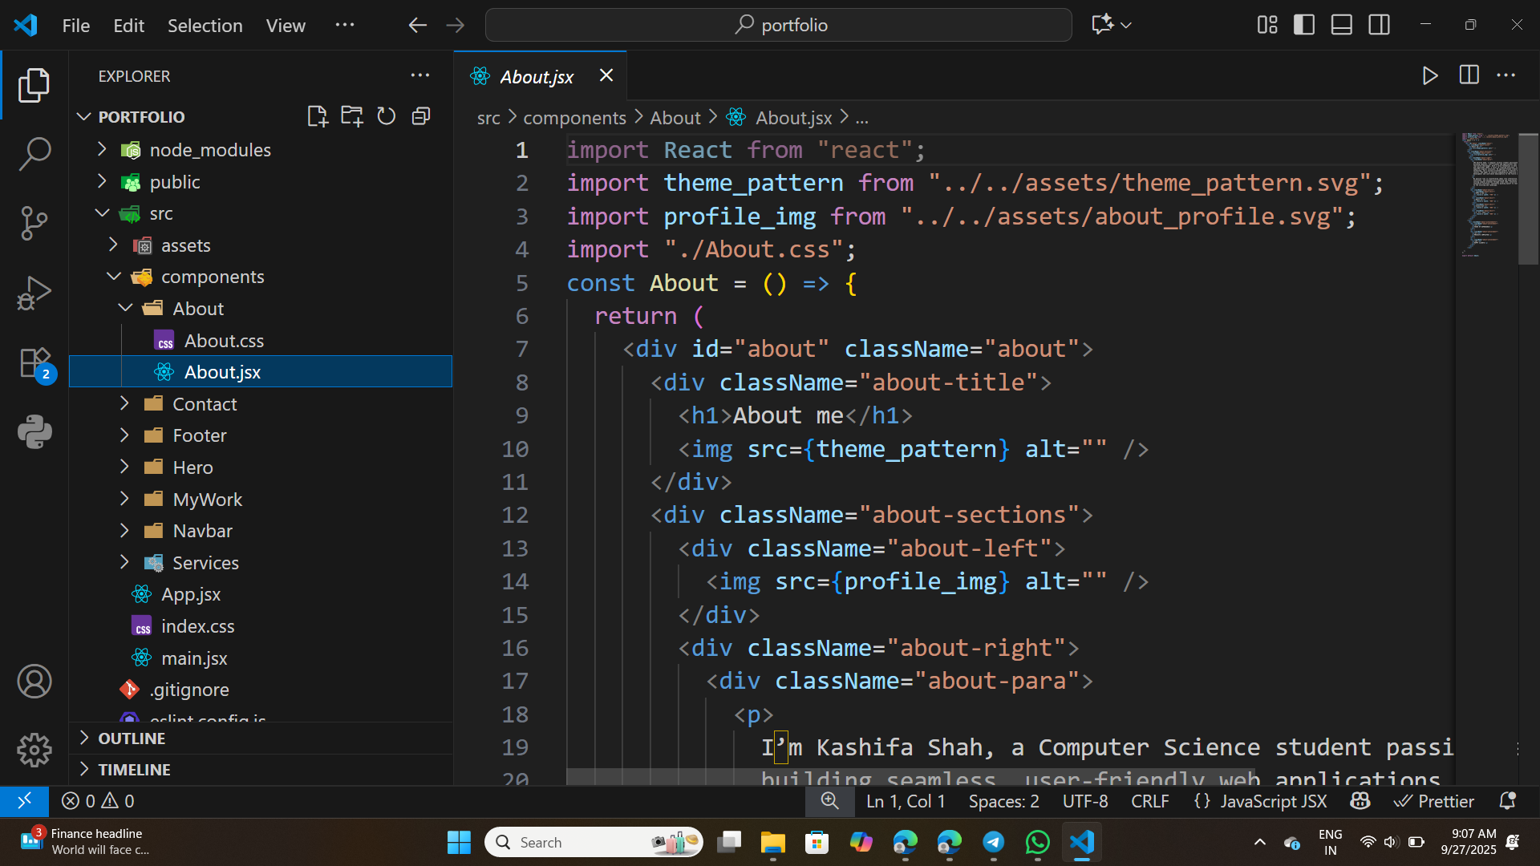

Slide 8
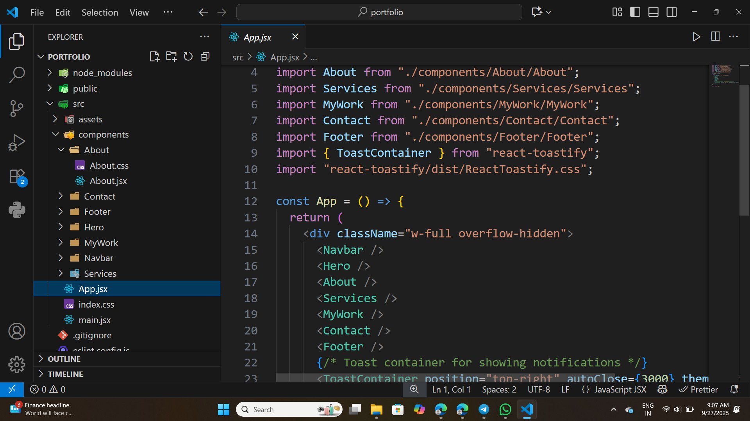

Slide 9
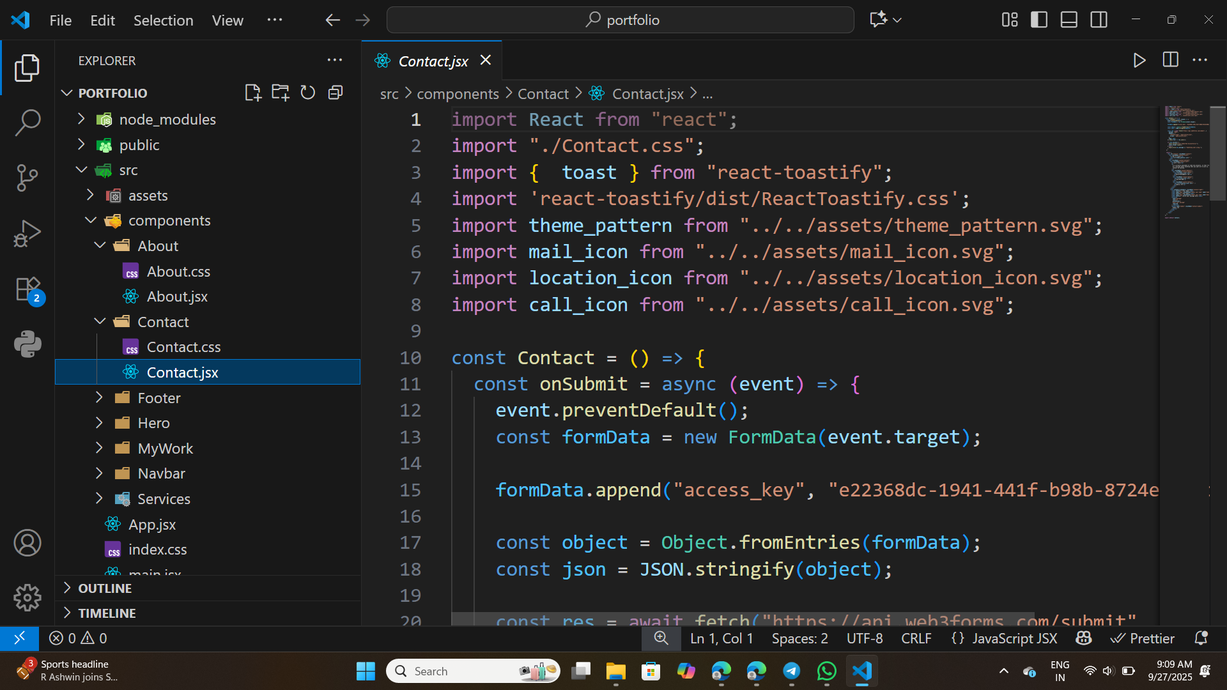

Slide 10
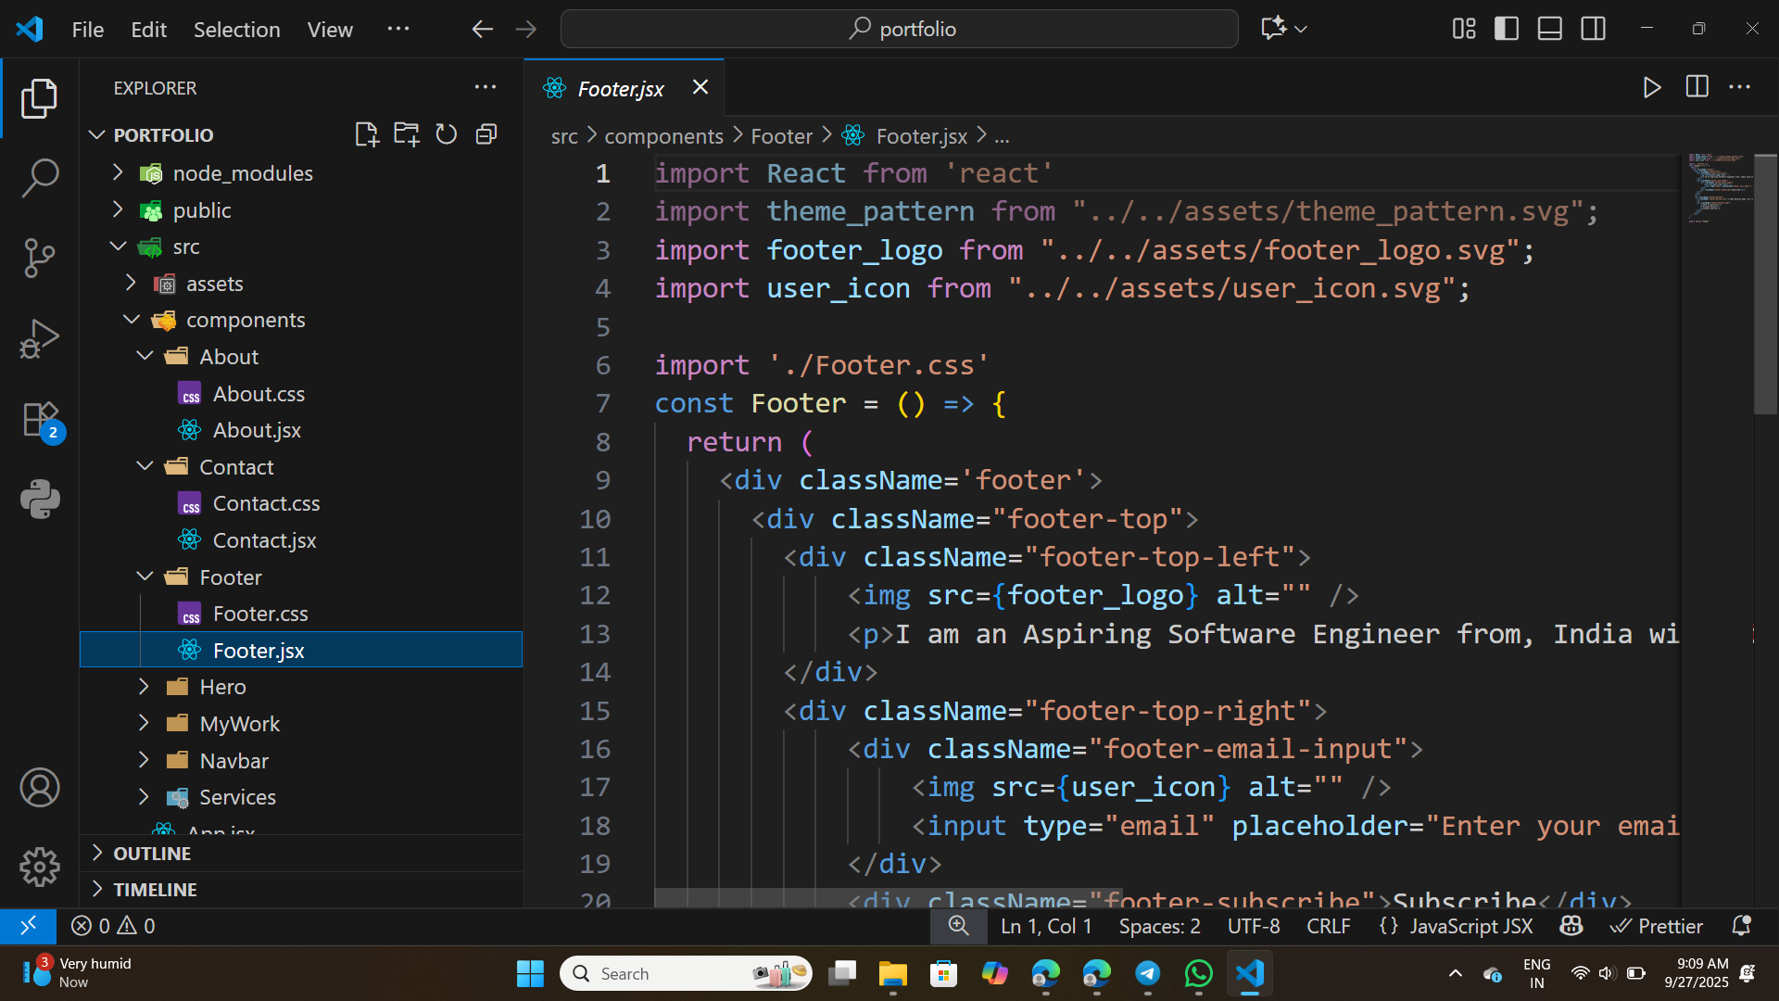

Slide 11
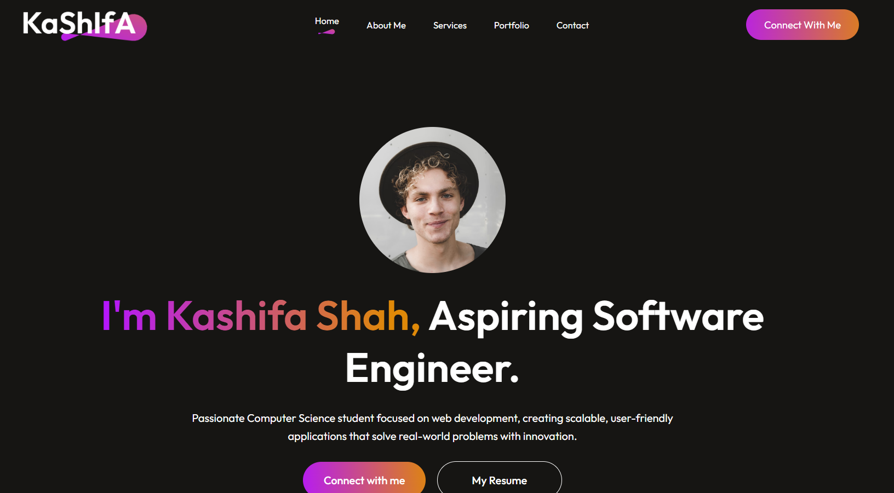
Output

Slide 12
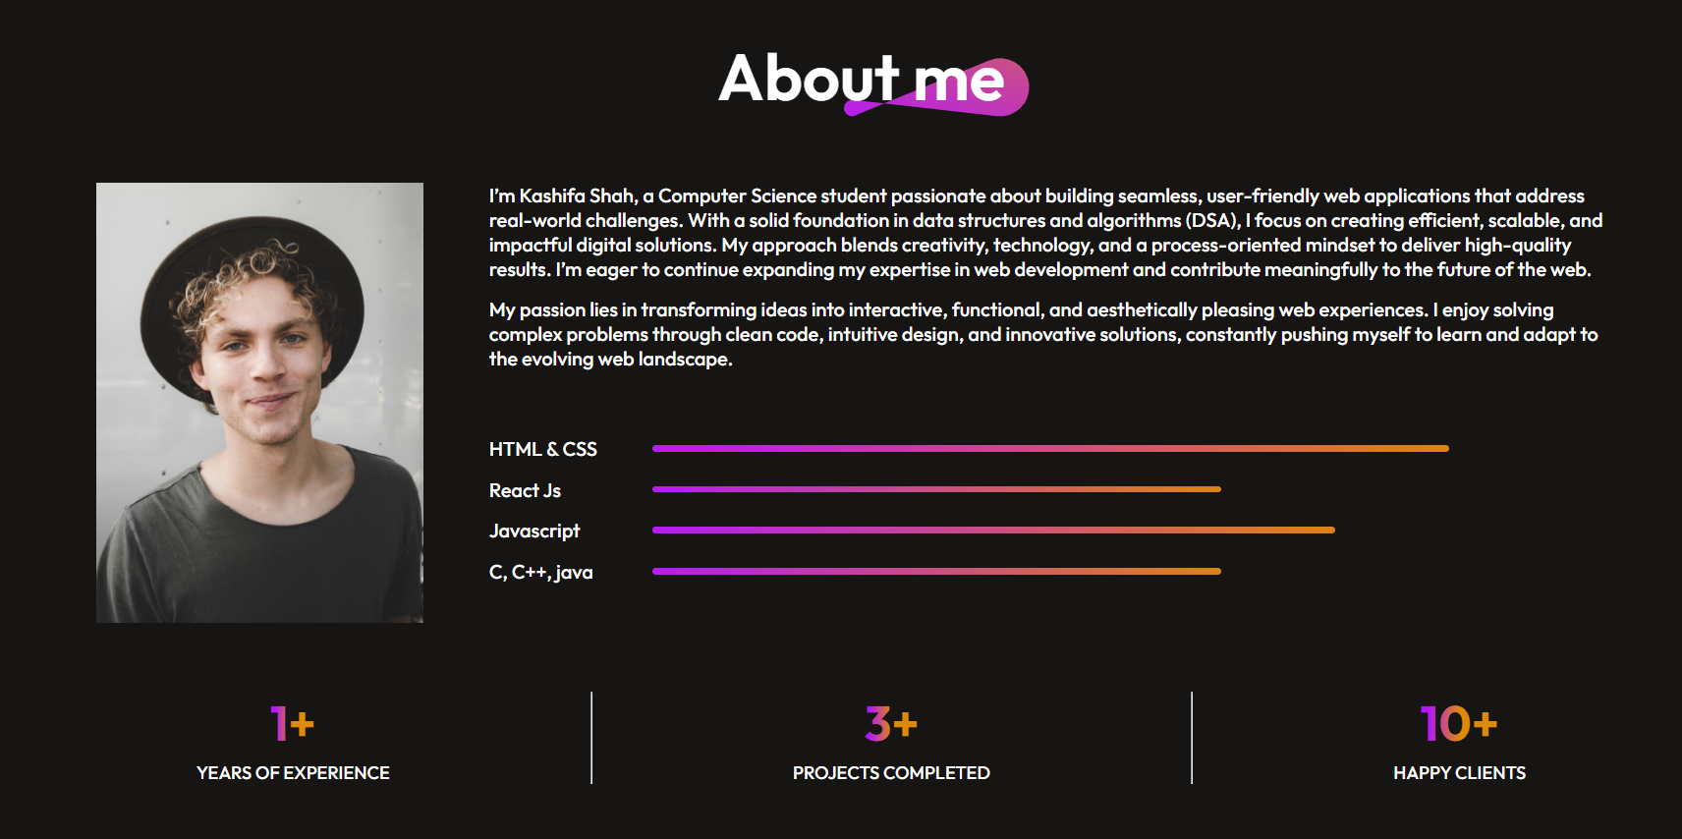

Slide 13
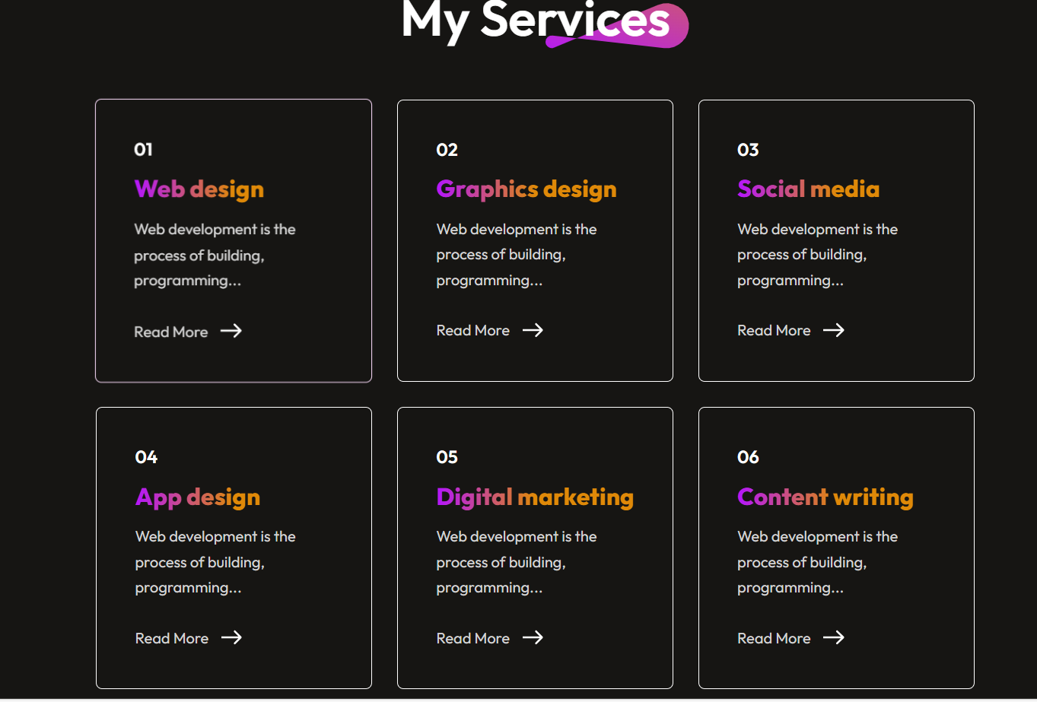

Slide 14
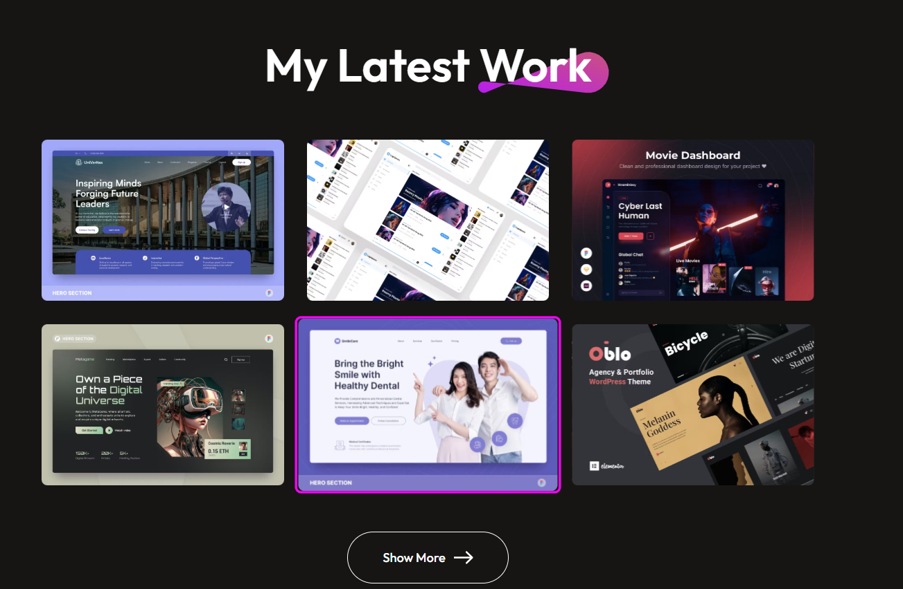

Slide 15
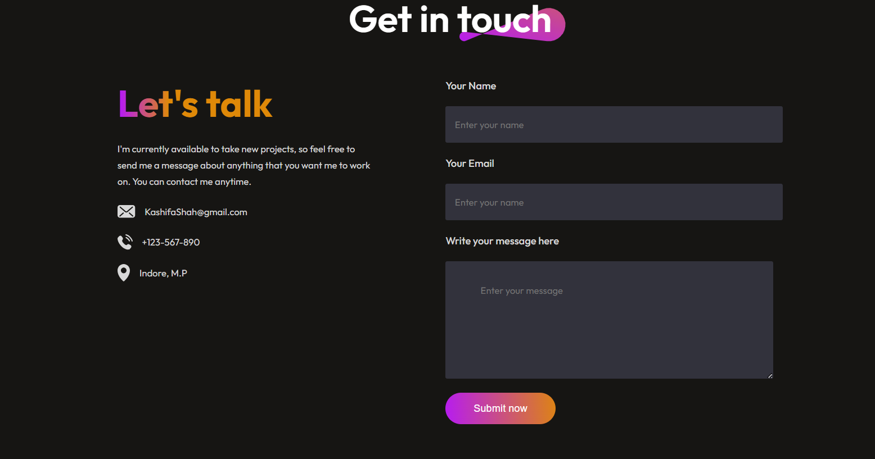

Slide 16
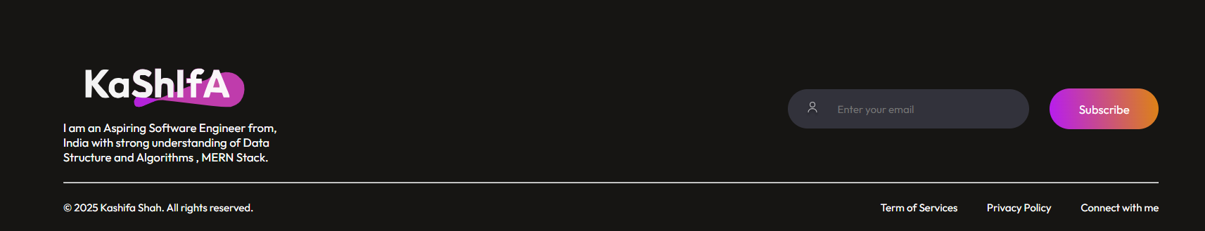

Slide 17
GITHUB AND DEPLOYMNET LINK
Github Link : https://github.com/kashifashah1/AICTE-Front-End-Internship
Deployment link: https://aicte-front-end-internship-9r5i-iaskw08a0-kas-projects-54a74a75.vercel.app/

Slide 18
CONCLUSION
This project showcases my ability to design and deploy practical, user-focused web solutions. Key takeaways include:
💡 Cost-effective online presence: Developed a solution tailored for small businesses to establish an affordable digital storefront.
🔄 Platform independence: Removed reliance on complex and expensive e-commerce platforms through a custom-built, lightweight application.
✨ Enhanced user experience: Focused on delivering an engaging and interactive interface that improves customer interaction and satisfaction.

Slide 19
FUTURE SCOPE(OPTIONAL)
To enhance functionality and provide a complete e-commerce experience, the following features can be integrated in future iterations:
🛒 Backend Integration (Node.js): Implement server-side logic to handle order processing, inventory management, and customer data securely.
💳 Secure Payment Gateway: Integrate trusted payment providers (e.g., Stripe, Razorpay, PayPal) to enable real-time and secure transactions.
🛠️ Admin Dashboard: Build an admin panel to manage product listings, track orders, and monitor inventory updates dynamically.
🤖 AI-Based Recommendations: Use machine learning algorithms to suggest personalized products based on user behavior and preferences.

Slide 20
REFERENCES
HTML Tutorial
CSS Tutorial
JavaScript Tutorial - Learn JS
React Tutorial Index
NanthiniMoha/TNSDC-FWD-DIGITAL_PORTFOLIO
Get started with Bootstrap · Bootstrap v5.3

Slide 21
THANK YOU

